Slide 1


BEER
MARKET
ANALYSIS
LISTEN!
TEAM E
Chris, Esther, Utkarsh, Amanda, Antonio, Max, Cheer

Slide 2
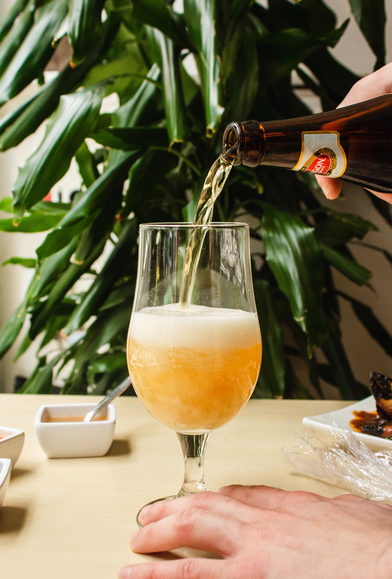






Fun Fact of BEER market in Spain
Spaniards drink 84 L/yr per capita
Beer consumption 12th in the world
6 big players in the beer market
70% of the package type is can
89% of the sales made in Spain are single serving (packages less than 500ml)
27% of the
sales are made
in 12 packs

Slide 3

What Customers Think
79%
88%
45%
There are enough brands in the market
They know what they want to buy before entering the stores
Willing to spend more on beers

Slide 4
3.17%
2.86%
3.79%
2.55%
Real values
Predicted values
Notes:
Decrease in the months of Fall
Increase in December (Christmas)
Predicted values based on an Arima (0,0,0) (0,1,0) – best model we could have- mean is not constant for each season

Slide 5
Total industry drivers Revenue
+6,59%
+8,21%
$1.498,37
$(7,09)
+5,00%
$40
$1.385
$21
$(5)
$81
$1.319
$50
2017
vol
price
mix
2018
vol
price
mix
2019

Slide 6
Total Available
Market
10B
Our Market Size
Total market share: 8.71%
Key Competitor
Market
7B
some of the point we might
want to mention .
Our
Market
3B

Slide 7
SOM 2019 YTD
MANUFACTURER 1
MANUFACTURER 2
MANUFACTURER 3
MANUFACTURER 4
MANUFACTURER 5
MANUFACTURER 6
OTHER MANUFACTURERS
SOM evo% 2017-2019 YTD
MANUFACTURER 1
MANUFACTURER 2
MANUFACTURER 3
MANUFACTURER 4
MANUFACTURER 5
MANUFACTURER 6
OTHER MANUFACTURERS

Slide 8
Our Company drivers Revenue
+7,70%
+10,54%
$183,13
$(0,84)
$5
+4,93%
$166
$3
$(1)
$14
$158
$6
2017
vol
price
mix
2018
vol
price
mix
2019

Slide 9


Insight
2019
Best Cluster :
Zero Alcohol ; Imported Premium
Less Promotion Less Sales
Lower Price is not always attractive
Main Competitor :
Manufacture 2
Manufacture 6 :
Private Label

Slide 10
Segmentation
- Retailer
Hypermarket
Supermarket
Larger Store ; Zero Alcohol
Less Can ; Less Zero Alcohol
Celiacs
Cheaper ; PET
PET ; National
Less Can ; Less Zero Alcohol
Zero Alcohol ; Imported Premium
Artisans

Slide 11
Go-to-Market Strategy
ASTURIAS
Who
Why
Reason For Targeting
Similar region to Cataluña
Losing the market share
Branding
Value prop and key message for customers
Value prop and key message for channels
Value prop and key message for other audiences
What
How
How should it be done
Tools for customers
Tools for internal audiences
External activities

Slide 12
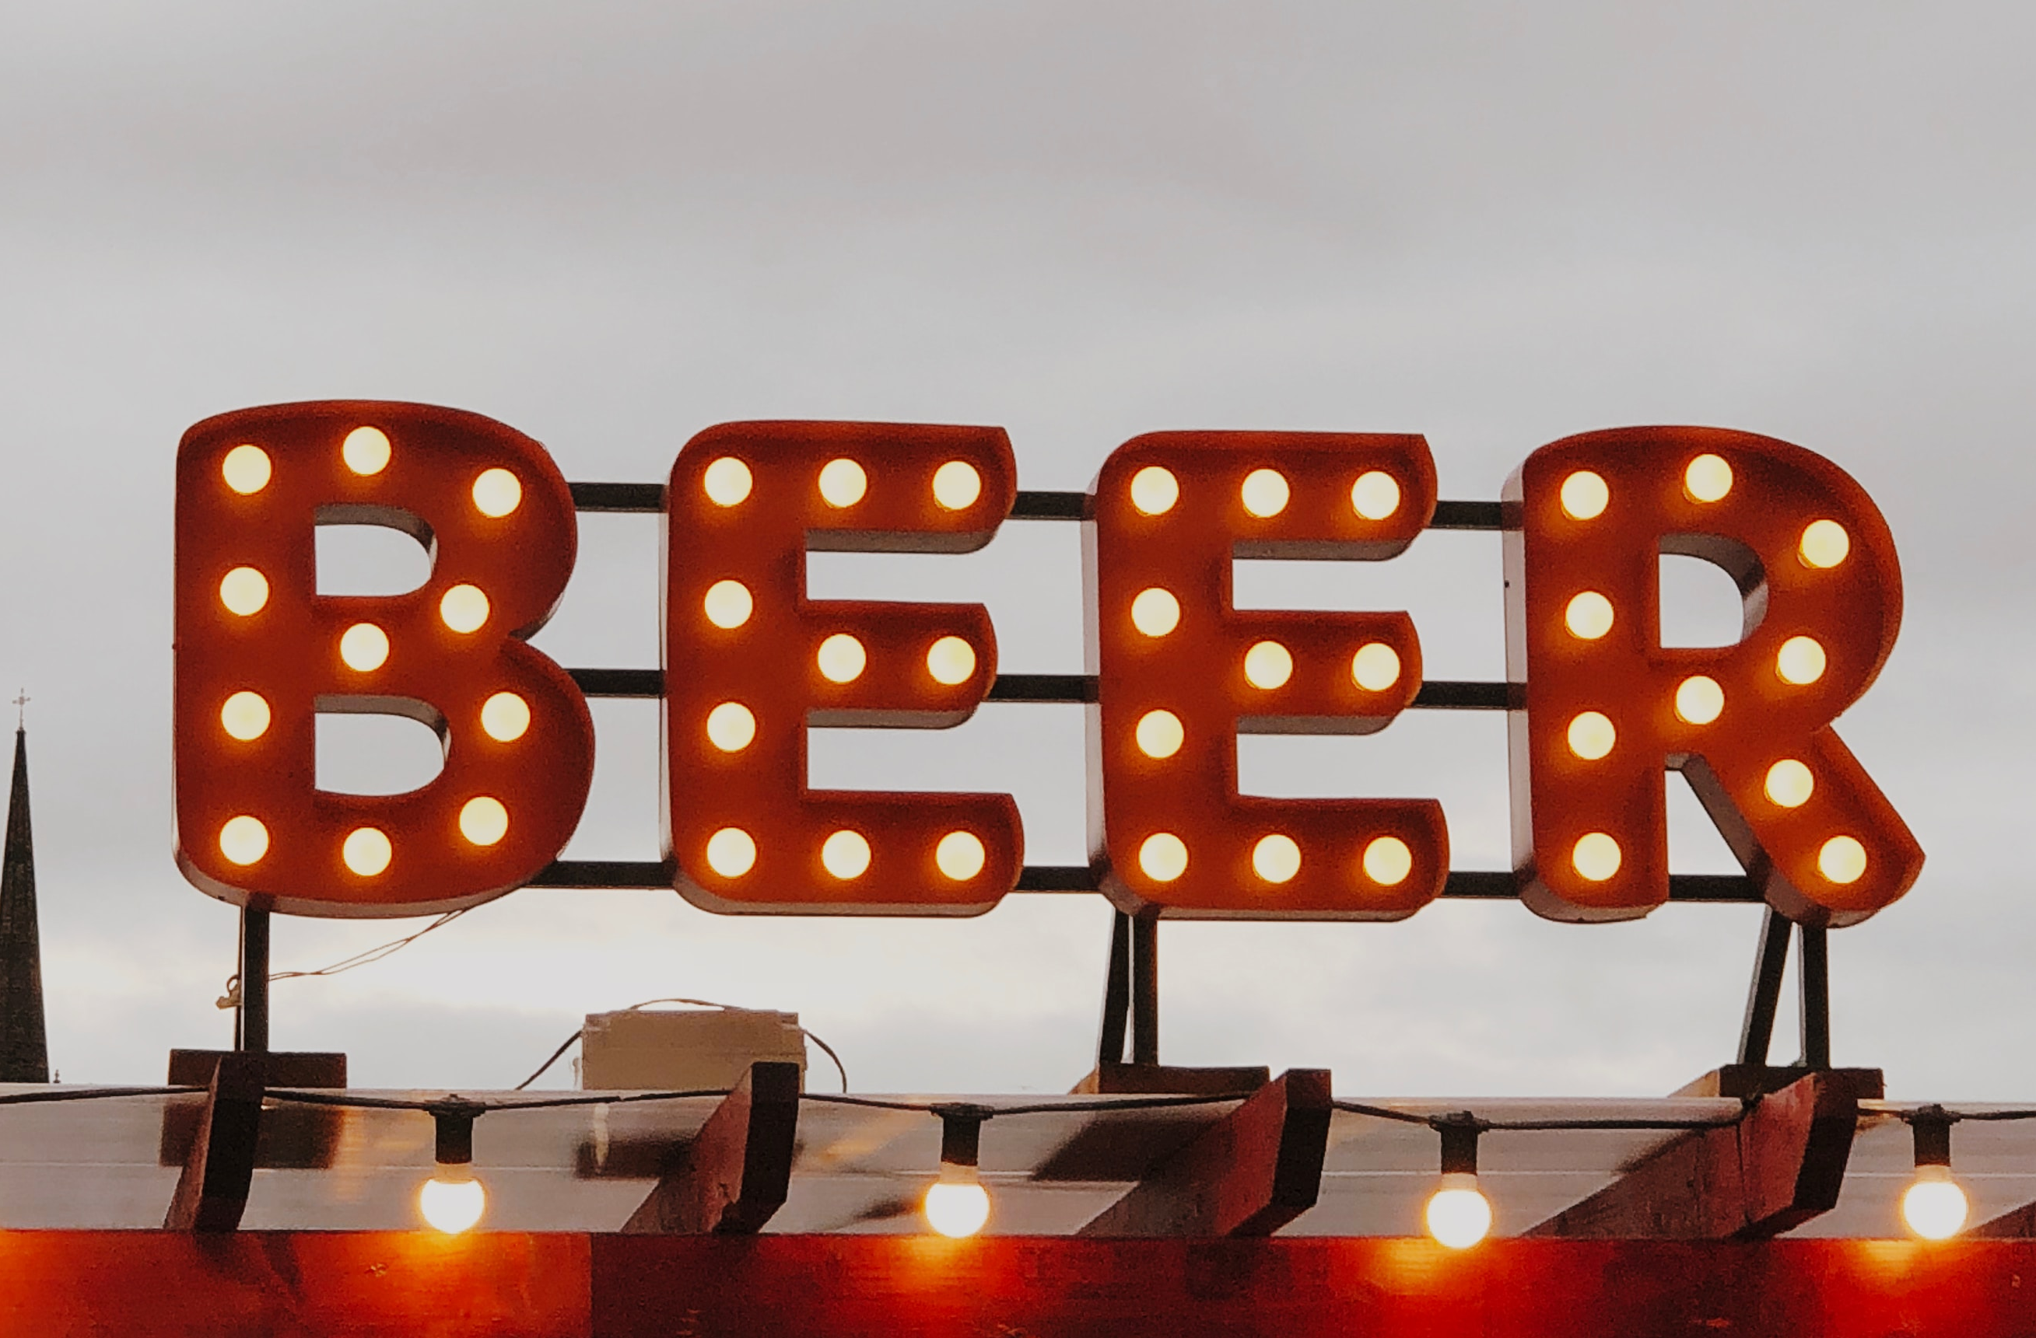
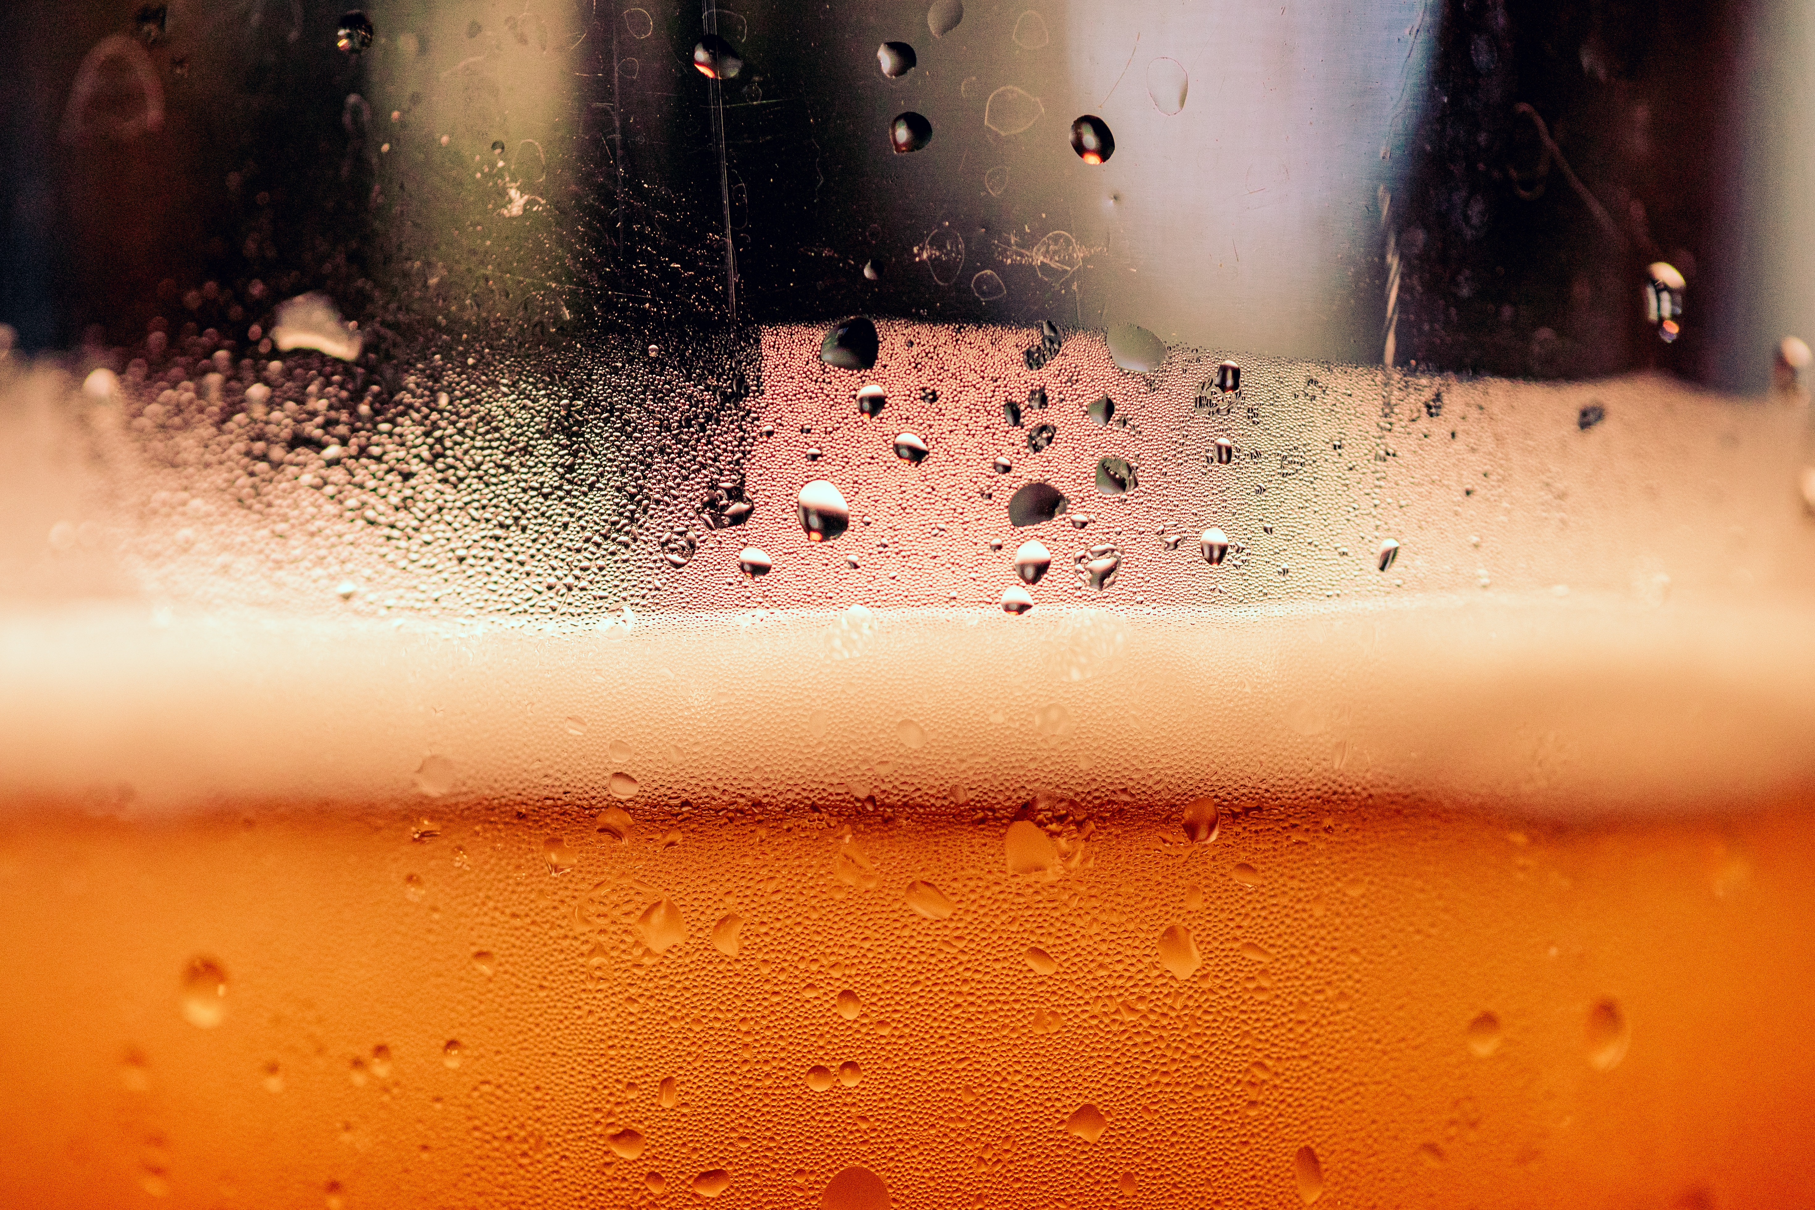
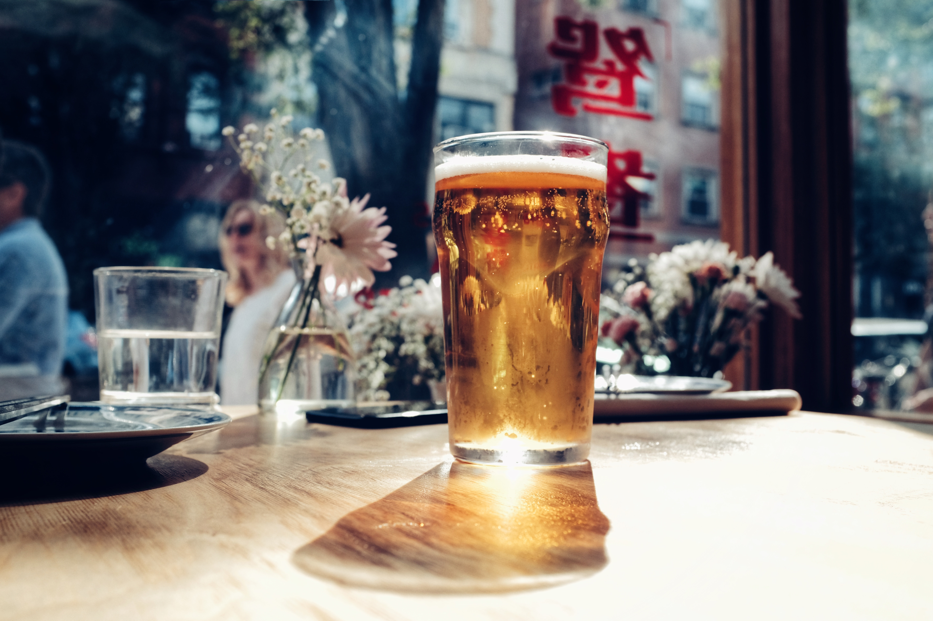

Slide 13
Brand – Volume 2017
0%
33.550
-16.487
5.250
-29.617
1.447
5.886
14.390
-11.241
-8.248
-61.498
11739237,49
152.952
11707981,29
-55.128
2017
250ML B1
330ML B1
500ML B1
660ML B1
750ML B1
250ML B2
330ML B2
1000ML B2
250ML OB
330ML OB
500ML OB
1000ML OB

Slide 14
Brand – Volume 2018
+11%
12983413
-1.400
-12.765
-1.619
-20.586
-6.884
727.445
11.739.237
204.534
2018
250ML B1
330ML B1
500ML B1
660ML B1
750ML B1
250ML B2
330ML B2
1000ML B2
250ML OB
330ML OB
500ML OB
1000ML OB
2019

Slide 15
Brand 2017 – 2018 - 2019
0%
+11%
+11%
84.221
31.453
84.418
902.889
2017
MAN 1 - BRAND 1
MAN 1 - BRAND 2
MAN 1 - OTHER BRANDS
2018
MAN 1 - BRAND 1
MAN 1 - BRAND 2
MAN 1 - OTHER BRANDS
2019

Slide 16
Channels 2017 – 2018 - 2019
0%
+12%
+12%
15.017
2017
Hyper
Super
2018
Hyper
Super
2019

Slide 17
Total industry drivers Revenue
+6,59%
+8,21%
$1.498,37
$(7,09)
+5,00%
$40
$1.385
$21
$(5)
$81
$1.319
$50
2017
vol
price
mix
2018
vol
price
mix
2019

Slide 18
Man-1 drivers Revenue
+7,70%
+10,54%
$183,13
$(0,84)
$5
+4,93%
$166
$3
$(1)
$14
$158
$6
2017
vol
price
mix
2018
vol
price
mix
2019

Slide 19
SOM total market
MANUFACTURER 1
MANUFACTURER 2
MANUFACTURER 3
MANUFACTURER 4
MANUFACTURER 5
MANUFACTURER 6
OTHER MANUFACTURERS
SOM evolution 2017-2019 Manufacturers
MANUFACTURER 1
MANUFACTURER 2
MANUFACTURER 3
MANUFACTURER 4
MANUFACTURER 5
MANUFACTURER 6
OTHER MANUFACTURERS

Slide 20
SOM Man-1 Regions
39,46
Andaluc√≠a
Arag√≥n
Asturias
Baleares
Cantabria
Castilla y Le√≥n
Castilla-La Mancha
Catalu√±a
Comunidad Valenciana
Extremadura
Galicia
La Rioja
Madrid
Murcia
Navarra
Pa√≠s Vasco
total
SOM evolution Man-1
5,33
Andaluc√≠a
Arag√≥n
Asturias
Baleares
Cantabria
Castilla y Le√≥n
Castilla-La Mancha
Catalu√±a
Comunidad Valenciana
Extremadura
Galicia
La Rioja
Madrid
Murcia
Navarra
Pa√≠s Vasco
total

Slide 21
SOM Man-1 Packages
Series 1
0,01
1000ML
250ML
330ML
500ML
660ML
750ML
total
SOM evolution Man-1
Series 1
1000ML
250ML
330ML
500ML
660ML
750ML
total

Slide 22
SOM Man-1 Brands
MAN 1 - BRAND 1
MAN 1 - BRAND 2
MAN 1 - OTHER BRANDS
total
SOM evolution Man-1
MAN 1 - BRAND 1
MAN 1 - BRAND 2
MAN 1 - OTHER BRANDS
total

Slide 23
31.256 (0,3%)
-2.723
-52.916
11739237,49
2.727
3.797
11.707.981
483
-13.611
2017
ARTISANS
BLACK
CELIACS
EXTRA
FLAVOURED
IMPORT PREMIUM
NATIONAL
WITHOUT ALCOHOL
ZERO ALCOHOL
2018
fix

Slide 24
1.244.174 (9,6%)
131
-2.358
12983411
743.510
-3.564
329.001
11.739.237
61.818
18.823
11.362
2017
ARTISANS
BLACK
CELIACS
EXTRA
FLAVOURED
IMPORT PREMIUM
NATIONAL
WITHOUT ALCOHOL
ZERO ALCOHOL
2018

